Slide 1

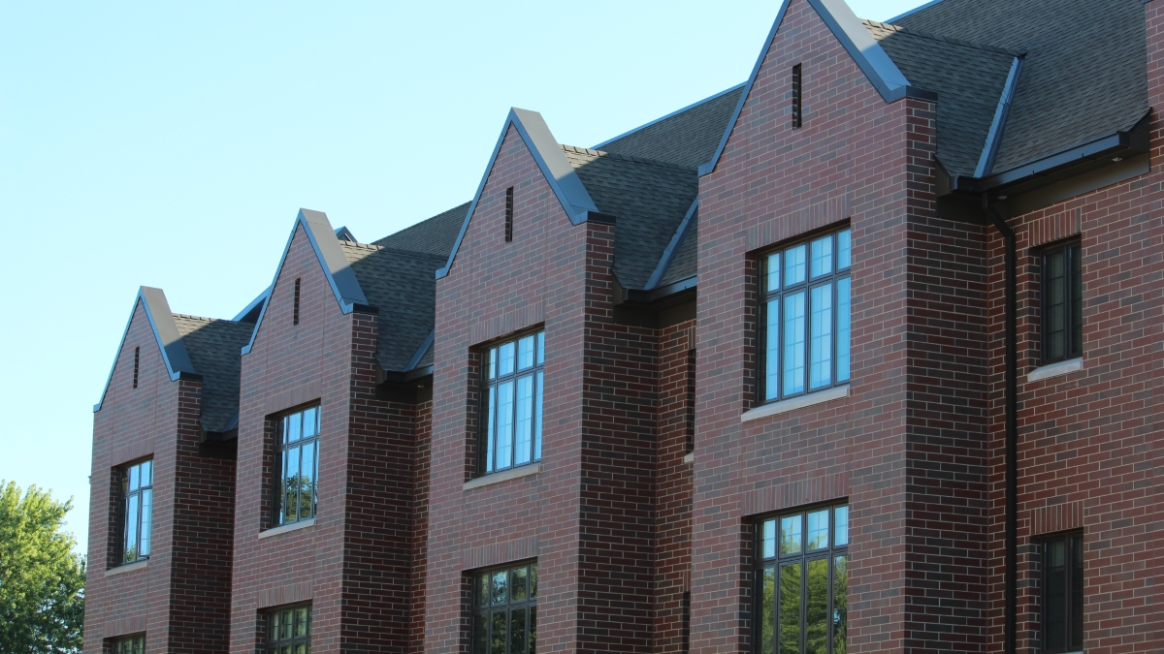
Sales Workout 8 -
Spec Development Best Practices
November 5th 2019
Notes:
Best option
Primary external cover slide format
WORK on a 2a option – reversed out option of triangle, white opacity for under slide
Simplify this as a base and show a version with no photography for internal

Slide 2
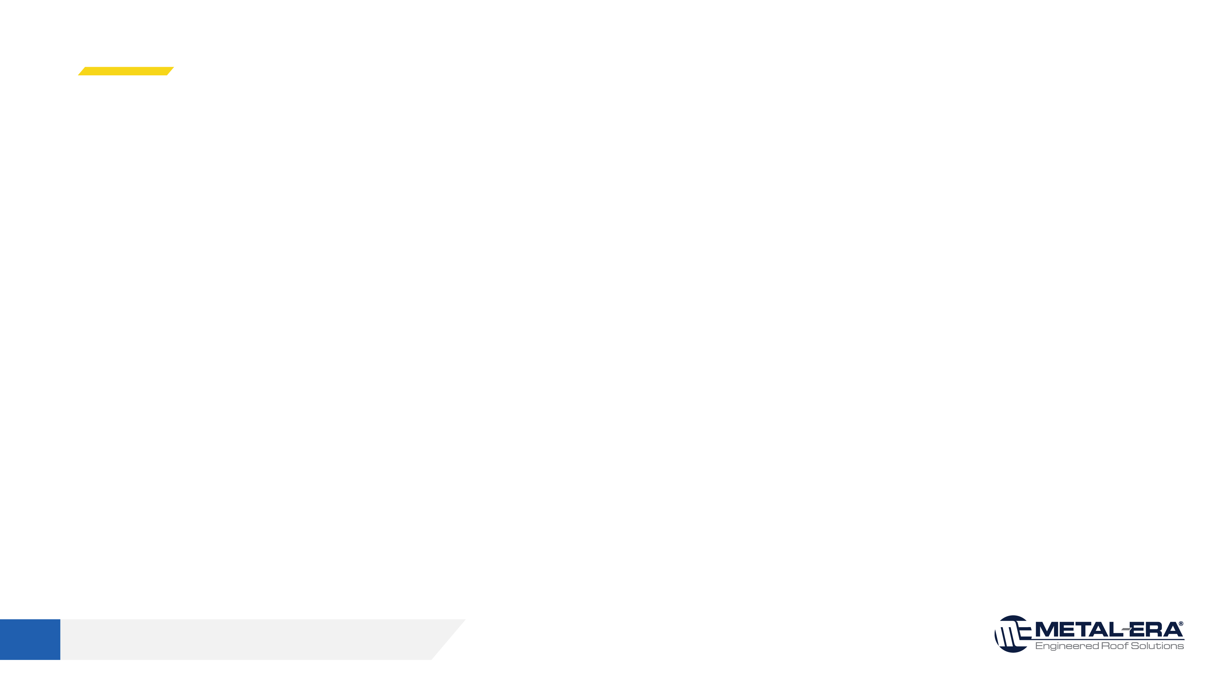
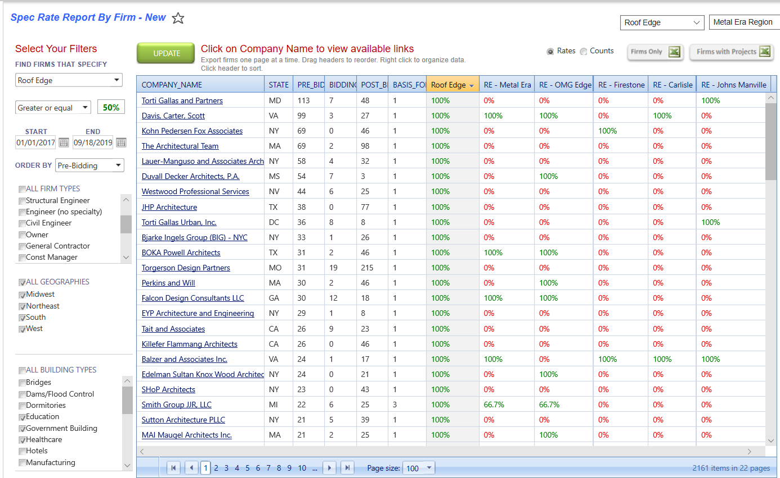
Spec Season Coming – Maximize Time
Each RBD has access to spec share, which tracks specification rate of ME versus standard roof edge
Sort by type (education, government, healthcare)
Sort by number of projects, location, and % of time their projects have a “Roof Edge”
Spend 15 minutes and maximize architectural investments
Sales Workout 8 • Internal use only. Do not distribute.

Slide 3
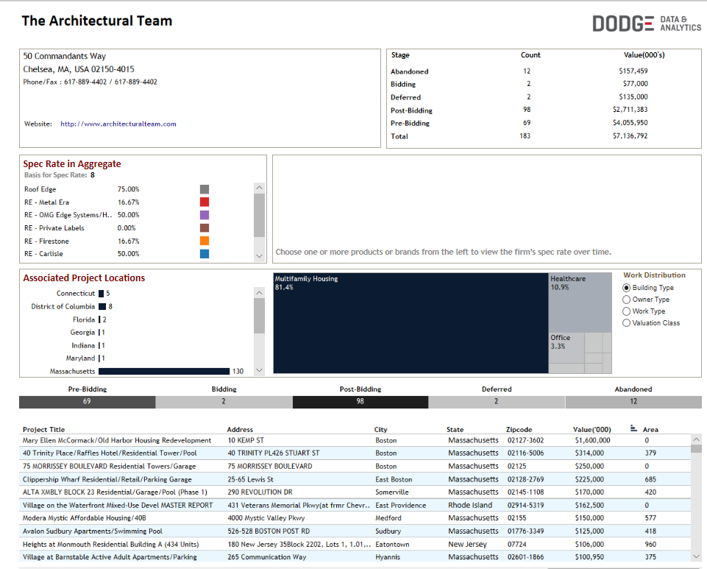
Dig 1 Step Further
Specific Projects in Pre-Bidding can then be discussed or reviewed
Visual on what they are currently specifying for edge and membrane
Arrange for more focused relationship development, perhaps while providing AIA CEU’s or PK session
It is not overly expensive to be a few steps more creative this winter season
Sales Workout 8 • Internal use only. Do not distribute.

Slide 4



AIA PPT’s have never “sold a project”, regardless of how fresh they are…. Build Relationships
Would You
Rather??
Sales Workout 8 • Internal use only. Do not distribute.

Slide 5
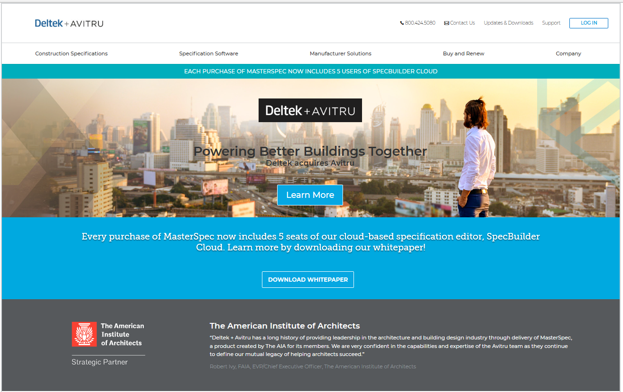
Know Your M-E Tools for Integrating
Masterspec is number one resource. Architects can search by Metal-Era in MasterSpec.
Metal-Era uses the paid version, which means our products are highlighted and easy to get
Avitru purchased Deltek, and this service is an AIA strategic partner, since MasterSpec was created by AIA specifically for it’s members use.
Steering AIA clients here reinforces spec relevance and legitimance
Sales Workout 8 • Internal use only. Do not distribute.

Slide 6
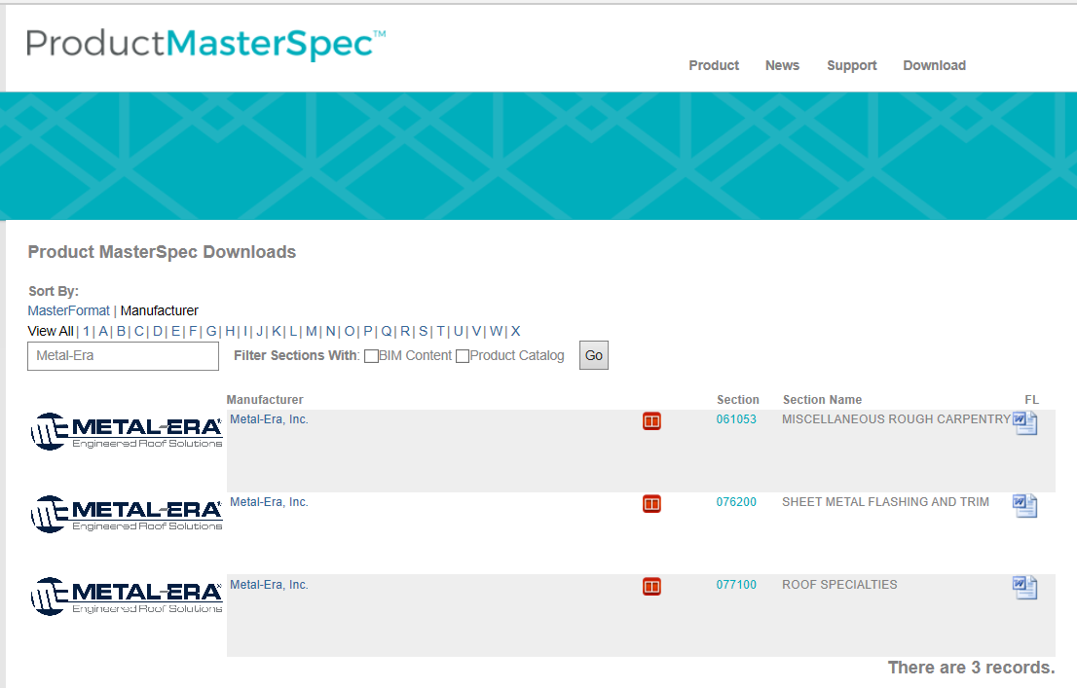
What a Specifier Sees
06153 – Nailer Specification (Alternate for Eliminailer)
076200 – Sheet Metal Flashing and Trim
077100 – Roof Specialties
6 Sales Workout 8 • Internal use only. Do not distribute.

Slide 7
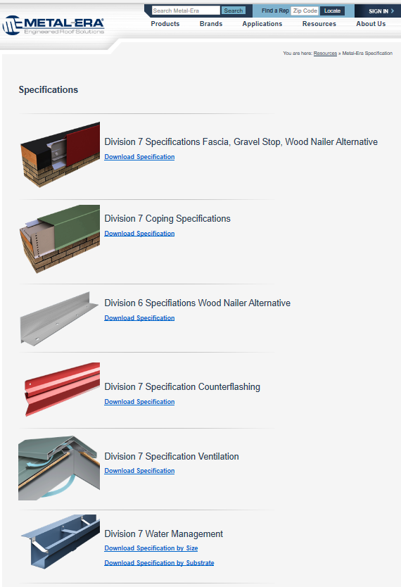
M-E Spec Page
The Metal-Era website also hosts specifications in CSI format
It’s broken into more categories by product type within the division 6 and 7 categories
These can be downloaded here, linked via email, or clients can be directed here.
www.metalera.com/specifications.aspx
7 Sales Workout 8 • Internal use only. Do not distribute.

Slide 8
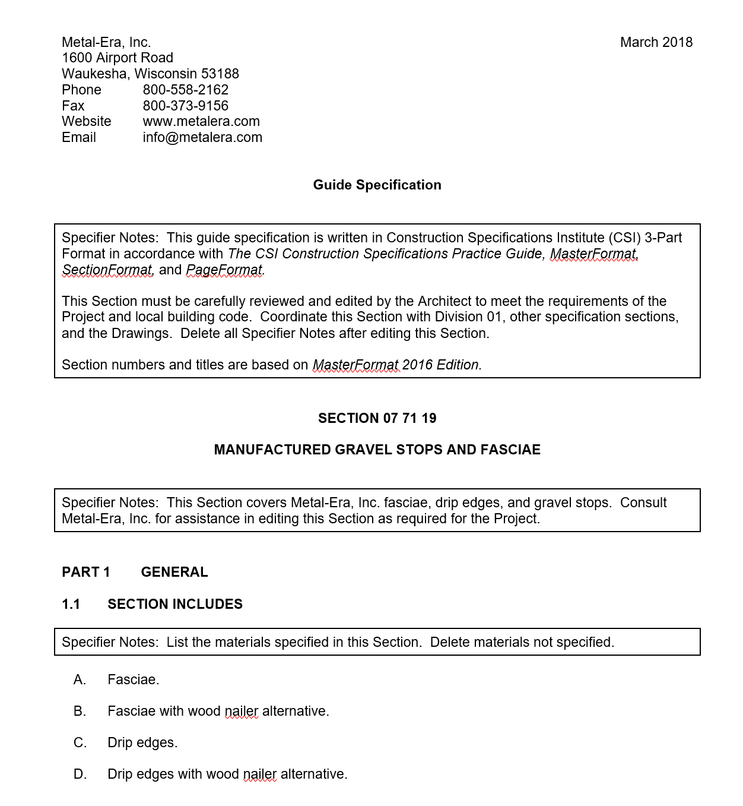
CSI Format Either Way
Guide spec downloads in word for editing with specifier notes in the CSI MasterFormat, whether you download from MasterSpec or from website
Fasciae is correct, we double checked, it looked funny
Some clients like consultants do not utilize CSI format, however, it is useful for many consultants who are now subcontracting to architectural firms to review AIA specifications for gaps
One interesting thought for each territory;
Email to your main architectural contact targets with link to Metal-Era now on master spec announcement?
Email to contacts with link to CSI spec links on ME page?
8 Sales Workout 8 • Internal use only. Do not distribute.
Source; Data USA website 5/5/19

Slide 9
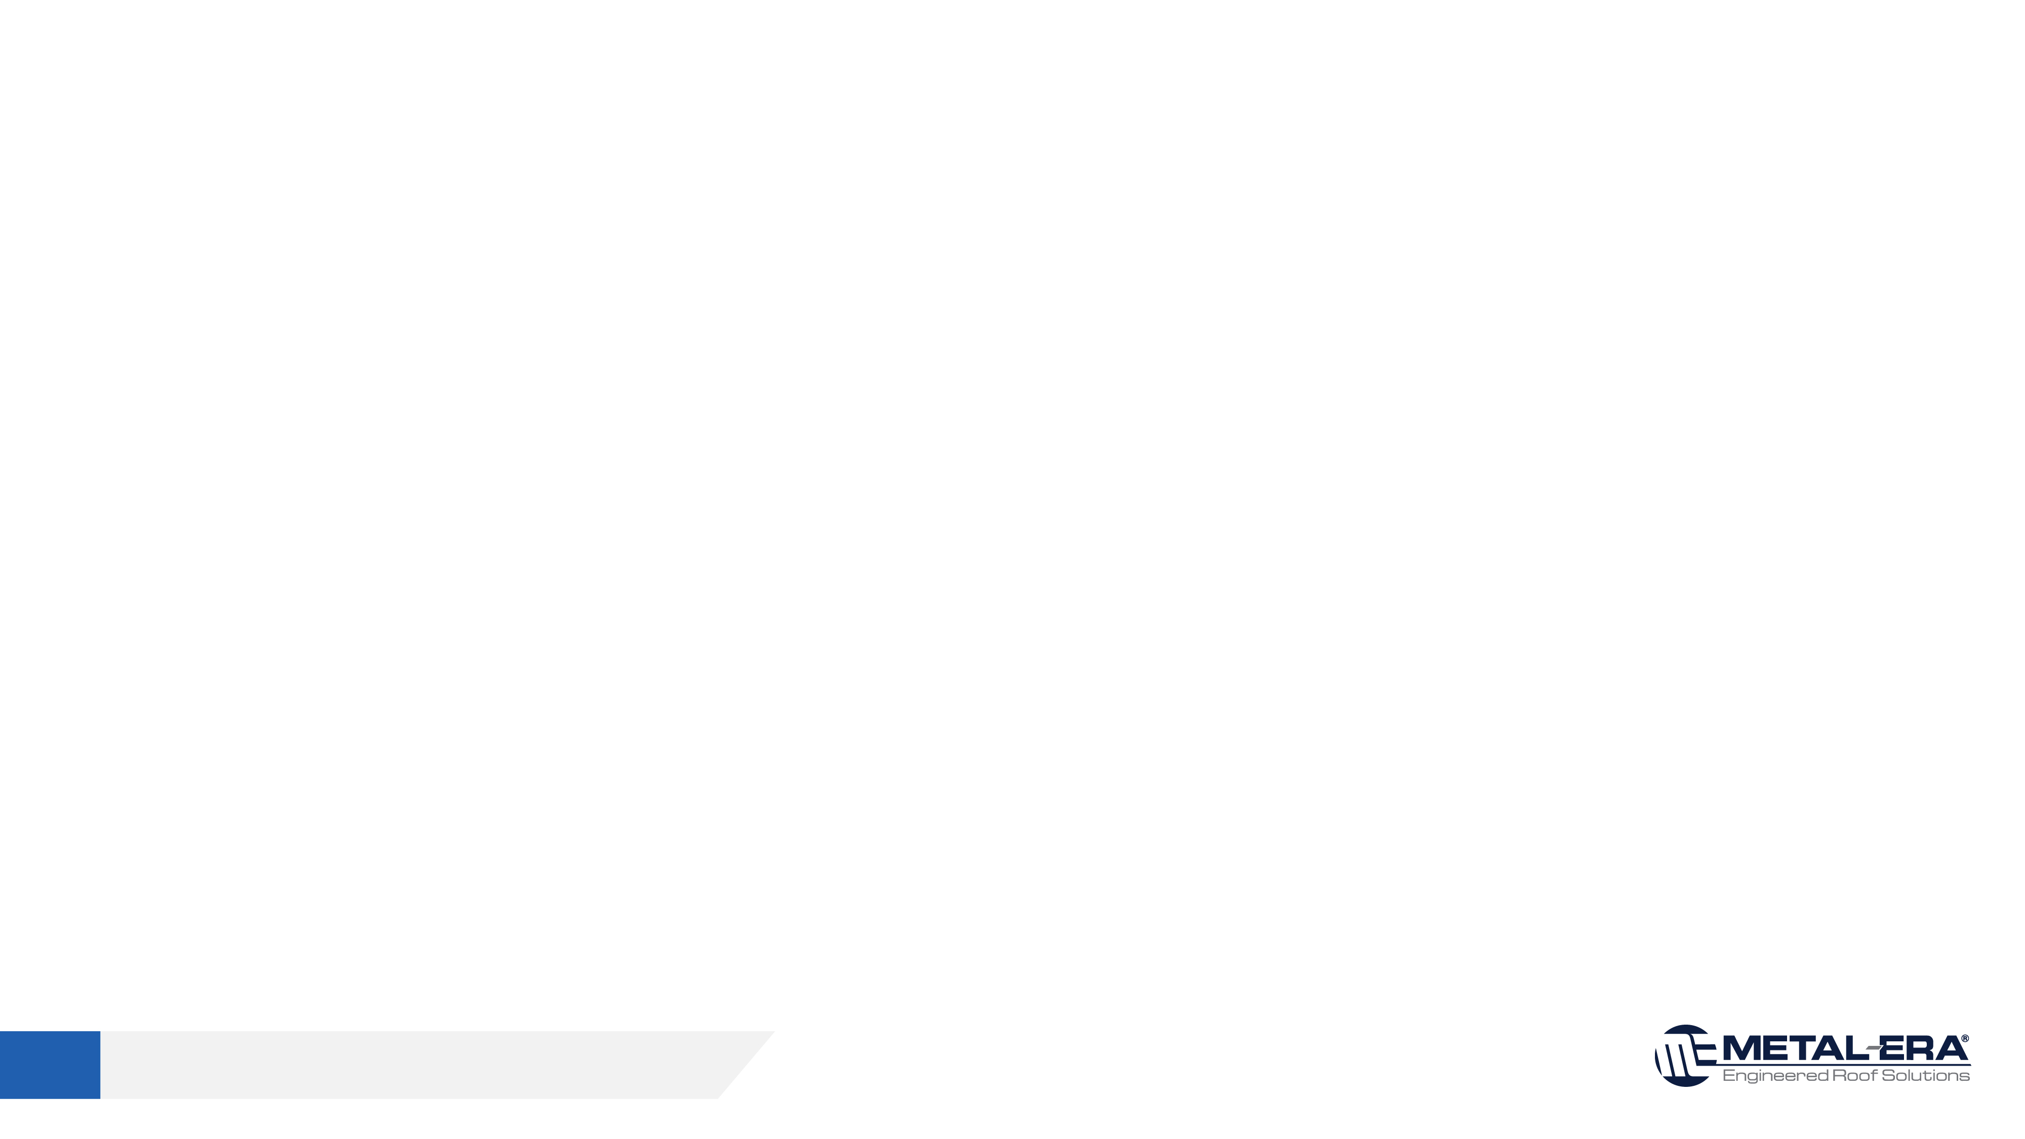
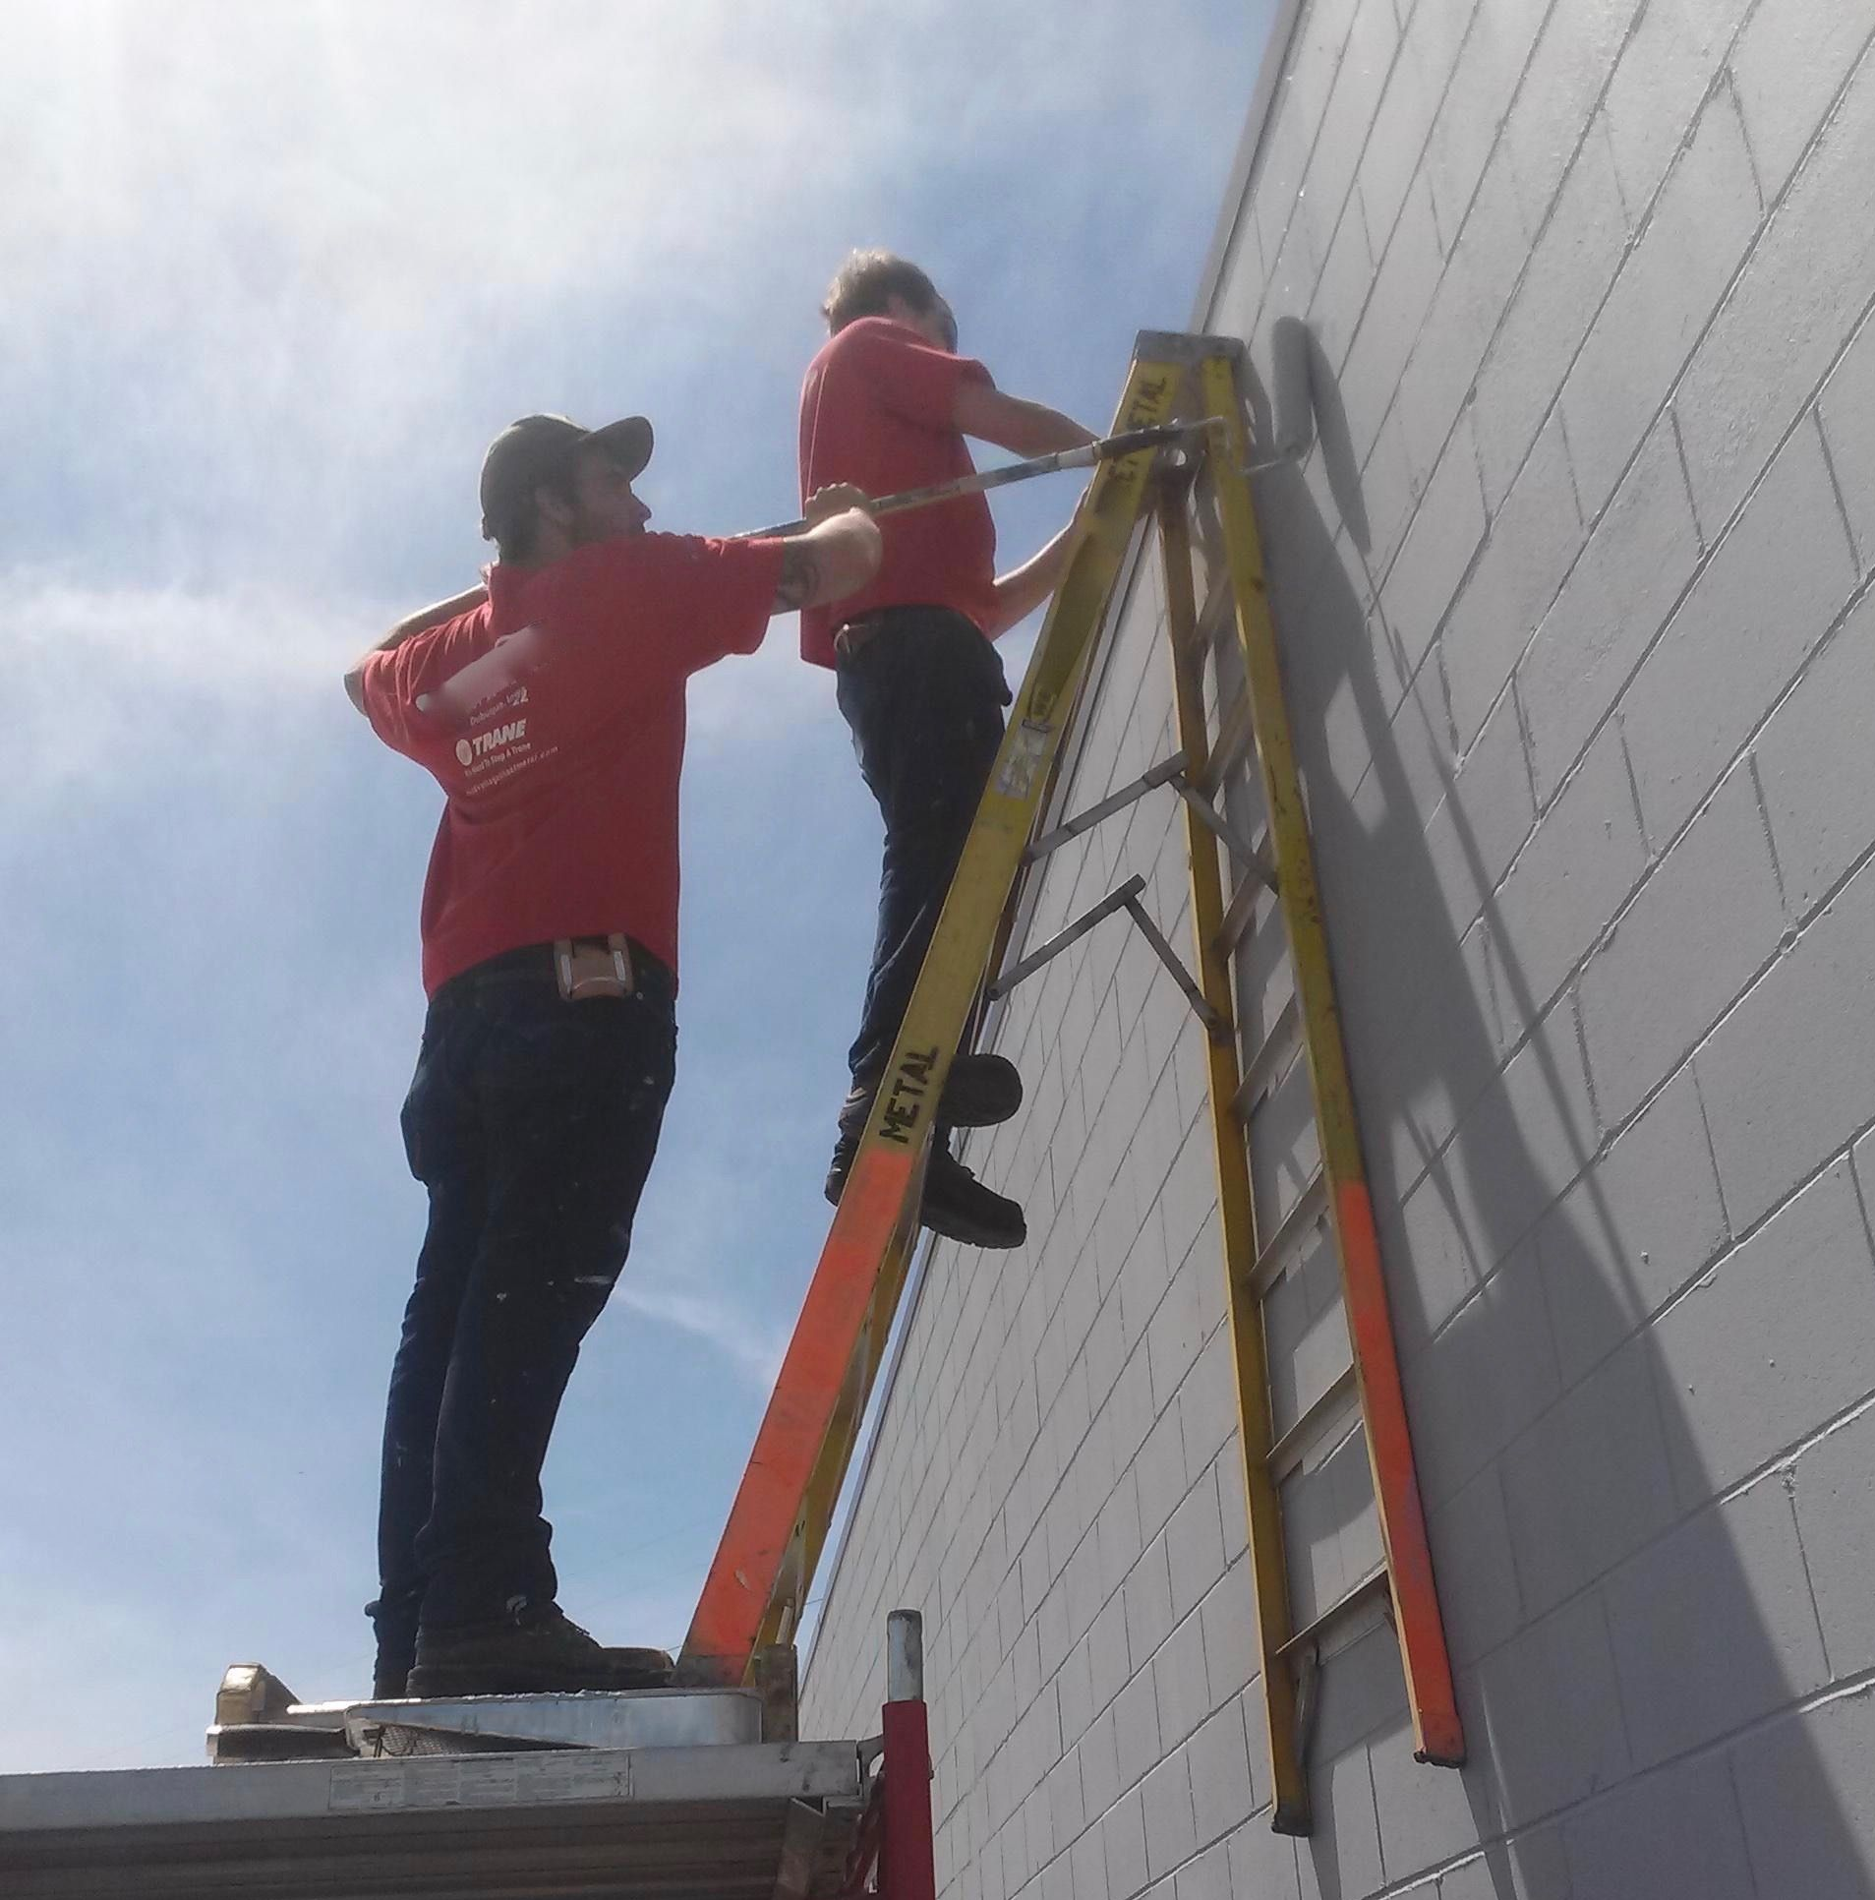
Plan for Q4 and Q1
Create target architect list with RBD help
Reduce targets to high value cat 3 and 4
Get creative to build relationship and show value
Understand how to integrate M-E for client
Provide simple conversion path
9 Sales Workout 8 • Internal use only. Do not distribute.

Slide 10
October NP 2019 Leaderboard (Through October 31, 2019)
Engineered Systems (Midwest) $24,539.92
Exterior Building Solutions (Northeast) $23,787.72
Halls Rep Group, LLC- So. TX (South) $17,112.92
National Leaders for Most Sales $2,500
Regional Leaders for Most Sales (1 per region) $1,000
Northeast: Exterior Building Solutions $23,787.72
South: Halls Rep Group, LLC- So. TX $17,112.92
Midwest: Diversified RFG. Solutions. $6,600.84
West: Strategic Building Products $9,725.40
National Leader for Most Eliminailer Sales $1,500
Engineered Systems (Midwest) $23,312.32
8 2019 Sales Contest • Internal use only. Do not distribute.

